Slide 1
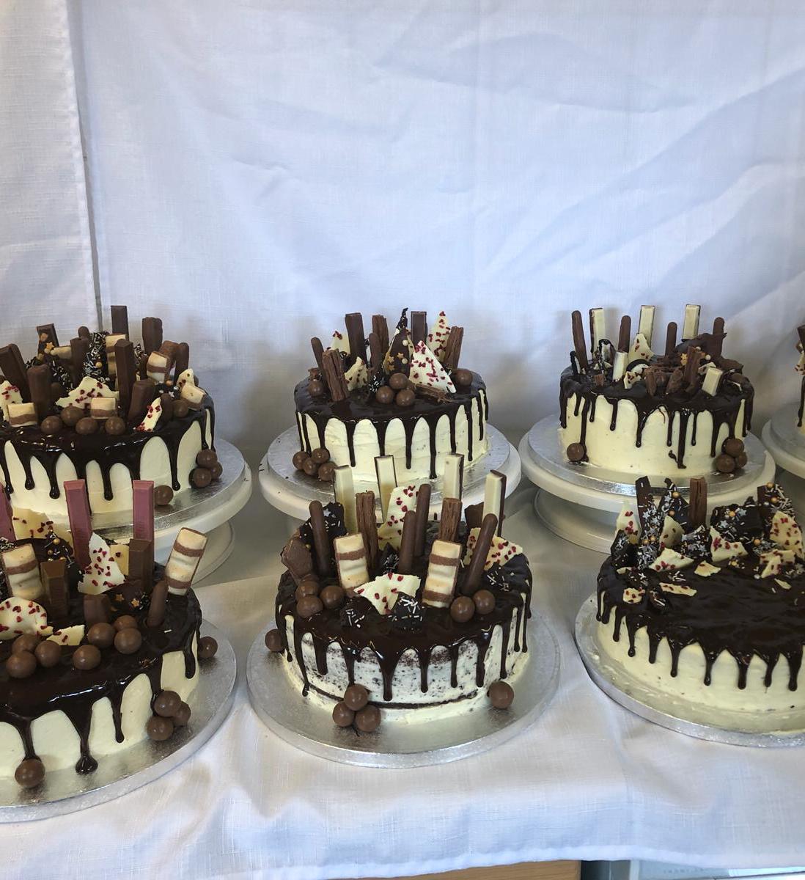
The Great Dunottar Bake Off

Slide 2
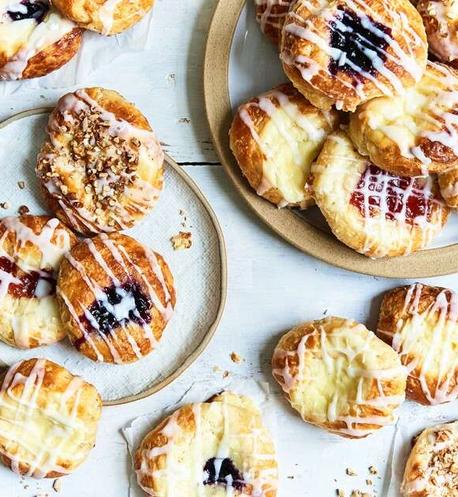
The Rules
The Bake Off is open to all students and all staff.
You do not have to take part every week; join in when you can.
Senior school students and staff must work independently.
Junior school and middle school students may ask for help, for example when using the oven, and are allowed an extra 30 minutes per challenge.
Students must have some form of supervision – please DO NOT cook alone in the house.
For each challenge, judges will award points for the top five entries. Every entry will also receive one point.
The competition will run during the school holiday.
Photos of your bakes must be emailed to Mrs. French by midnight on the deadline day. (See schedule below)
There will be prizes for the overall winners.

Slide 3
Bake Off Entries and Administration
To sign up please email Mrs French a.french@dunottarschool.com.
Please include the name of all the people who are going to participate and if you are a student please include your year group.
I will share images of the winning entries with you all so that you can see the competition!

Slide 4
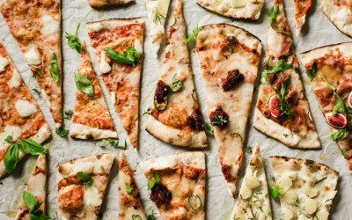
Judging Criteria
Without being able to taste the dishes, judging will be based on; the range of skills demonstrated, creativity and the presentation of the final dish.
Top Tips
Take some photos whilst you are making your dish. This can be added to your entry and used as evidence of the skills you have used. However, remember I will be sharing some of these images, so be mindful of what is in the background.
Choose a dish that you will be able to complete in the time given, but that allows you to demonstrate as many skills as possible.

Slide 5
Prizes
Small prizes will be awarded for the winners of the following categories:
Total points awarded
Most creative dish
Best final challenge dish

Slide 6
Any questions?
If you have any questions please email Mrs French. (A.french@Dunottarschool.com)
Good luck!

Slide 7
 | Challenge | Criteria | Deadline | Time
1 | Pizza | Make a pizza using your own choice of home-made base e.g. bread dough, scone based, flatbread, home-made pastry etc. | 5/4 | 1h30
2 | Biscuits | Make a batch of twelve decorated biscuits which fit the theme ‘Spring’. | 12/4 | 1h30
3 | Pastry | Make a sweet or savoury pie. You can use any type of pastry, but you must make it yourself! | 13/4 | 2hrs
4 | Cake | Make a decorated cake that would appeal to an elderly person. Can you think of anyone that you could give the cake to? | 19/4 | 2hrs
5 | Bread | Make a batch of 4-6 shaped bread rolls. They must either use yeast, or bicarbonate of soda as a raising agent. | 26/4 | 2hrs
6 | Leftovers | Make any dish of your choice which you think makes good use of leftovers and store cupboard ingredients. This doesn’t need to be a baked dish. | 3/5 | 1h30
7 | Celebration | Make a dessert for a birthday party. It should feed at least six people. | 10/5 | 2hrs
8 | Final: Afternoon Tea | Make two dishes that could be served at an afternoon tea. They must be different e.g. one cake, one pastry. | 24/5 | 3hrs

